Slide 1
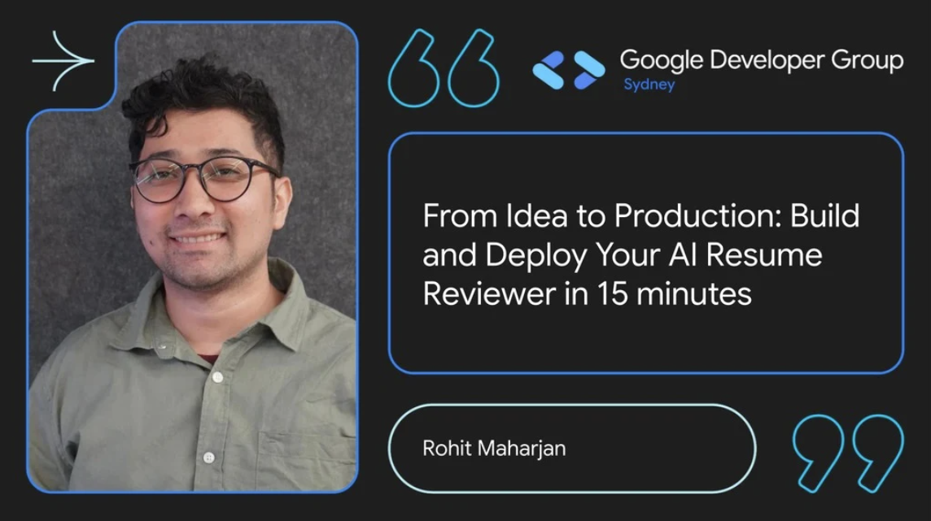

Slide 2

My Background

Slide 3

How long does it usually take you to build and deploy a small app?

Slide 4
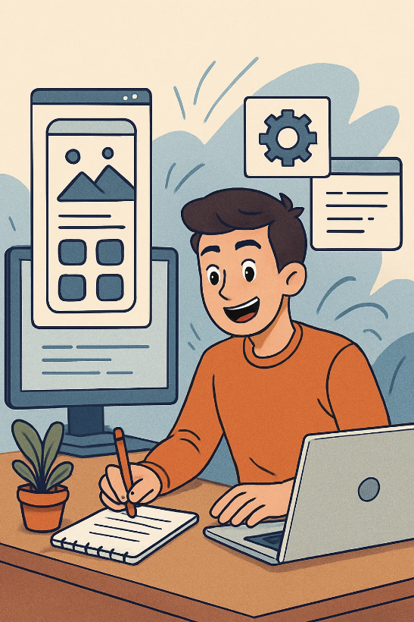
You start building apps with enthusiasm and interest

Slide 5
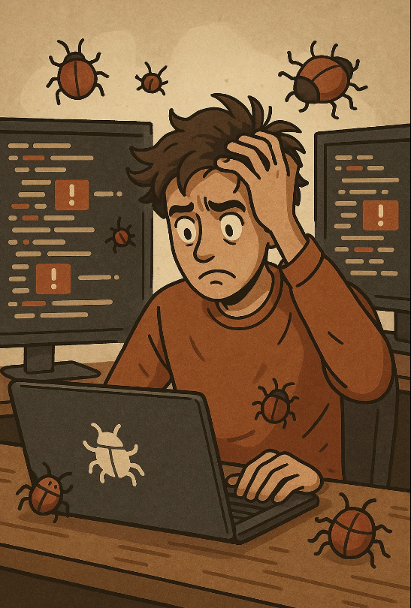
Unexpected Bugs Hours spent debugging mysterious errors that weren't in the tutorial

Slide 6


Slide 7

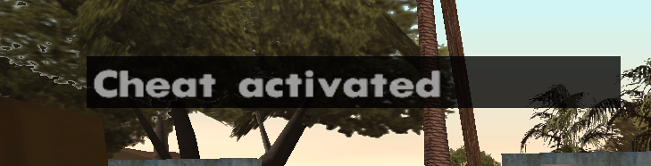
What if I told you I have GTA cheat code to make it?

Slide 8


Our Tech Stack
Google AI Studio
Google Cloud Run
A user-friendly platform for building AI-powered applications without extensive coding knowledge. Provides access to Google's advanced language models and intuitive interface for prompt engineering.
A fully managed compute platform that automatically scales stateless containers. Perfect for deploying web services without worrying about infrastructure management.

Slide 9
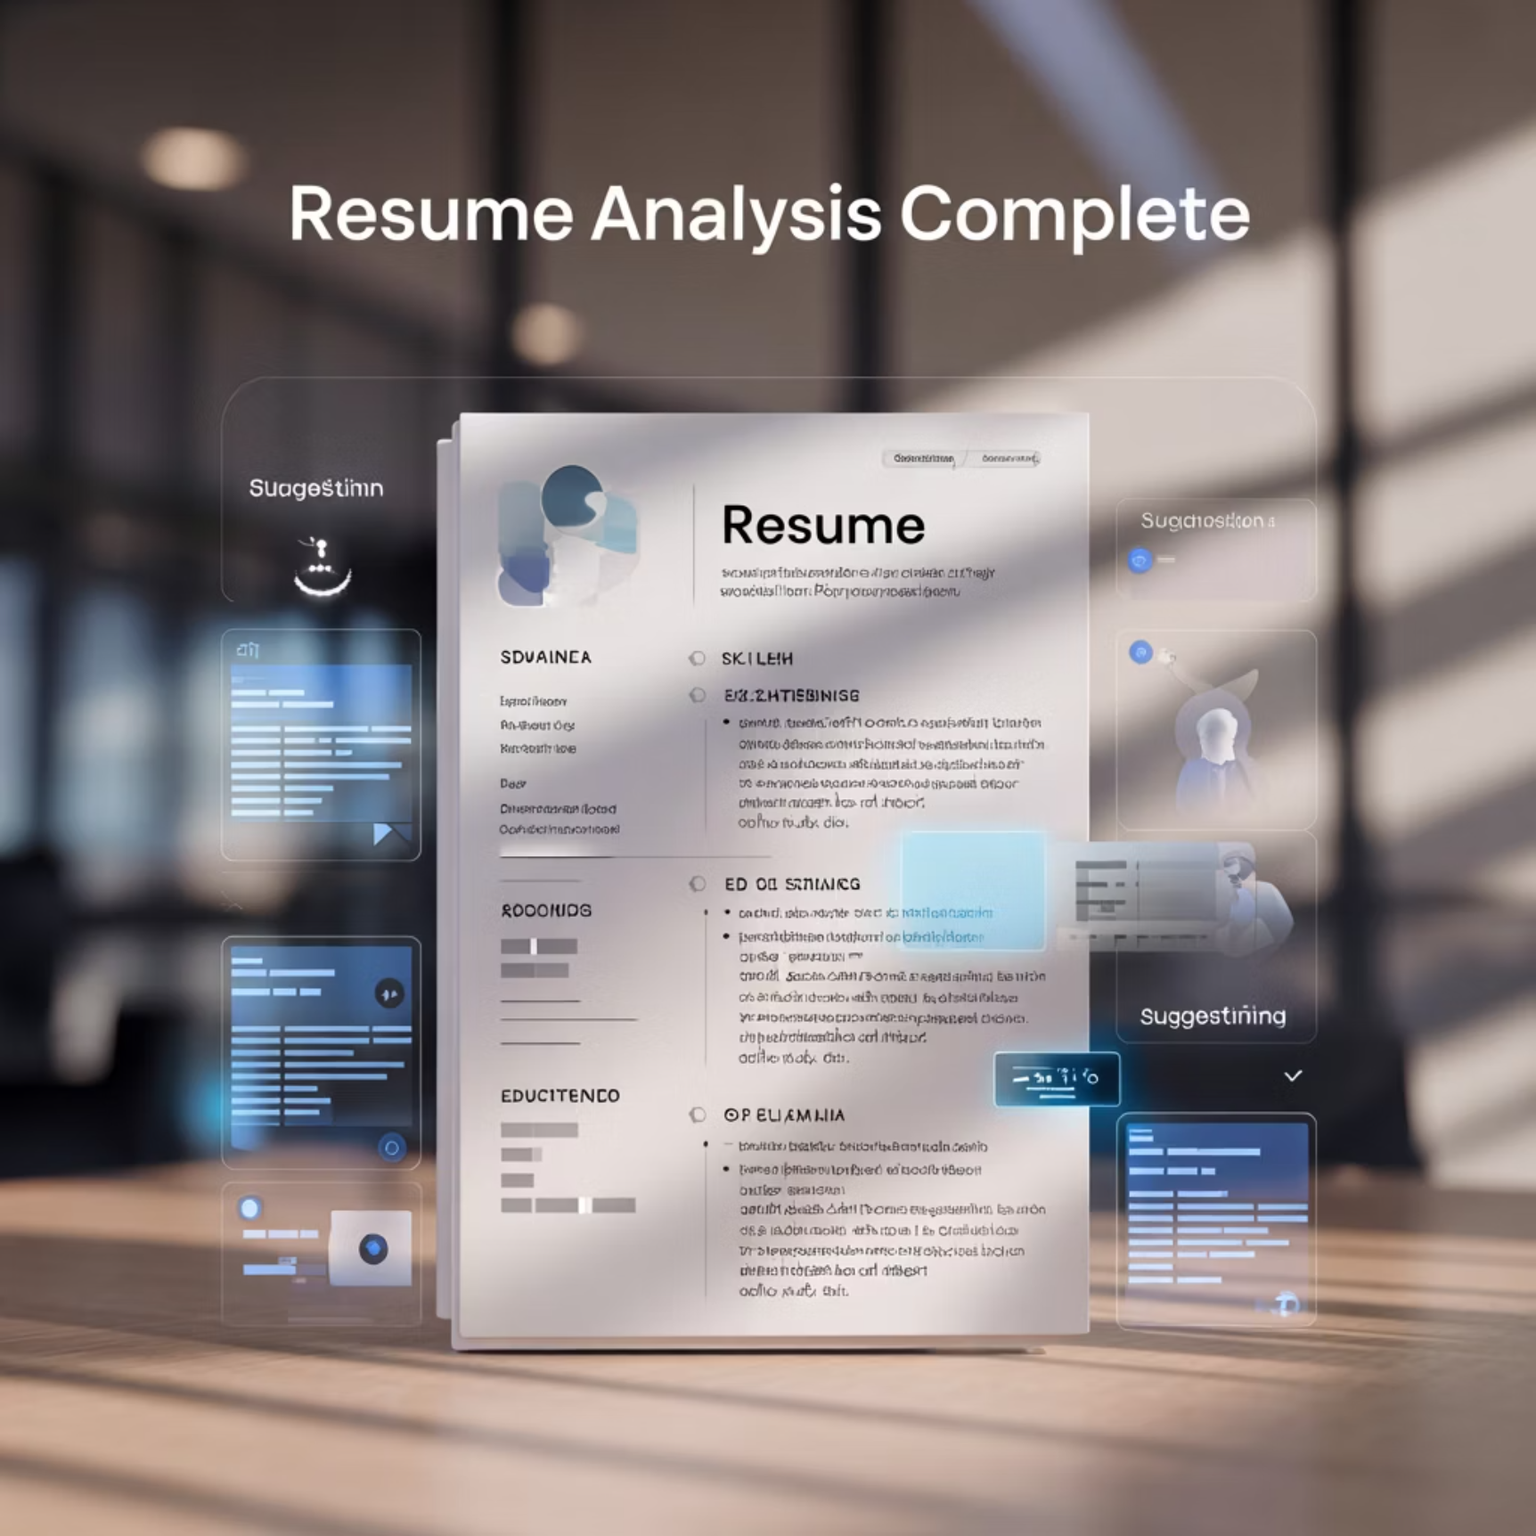
What We're Building Today
AI Resume Reviewer App
A practical application that leverages
artificial intelligence to:
Analyze resume content and structure
Provide personalized improvement suggestions
Highlight strengths and weaknesses
Compare against industry standards
Benefits

Slide 10
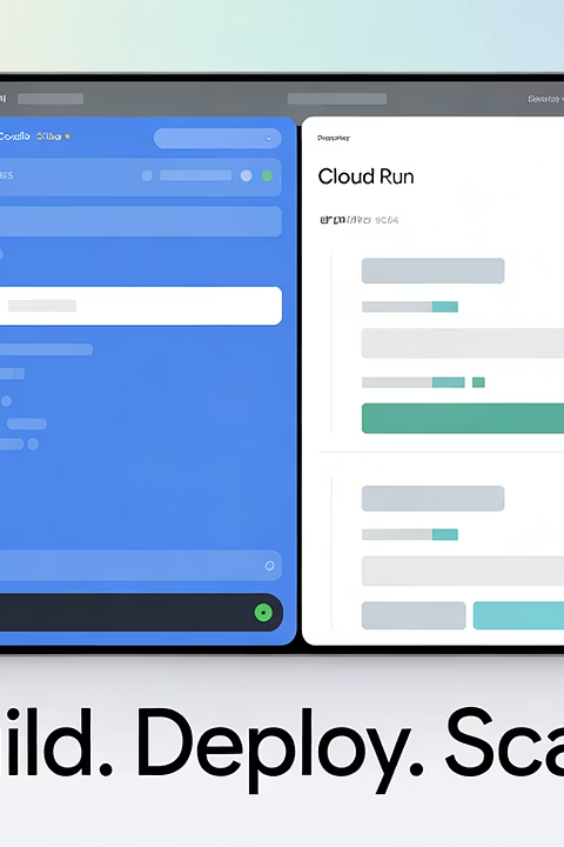
The 5-Minute Development Process
Create AI Studio Project
Sign in to Google AI Studio and create a new project specifically for resume analysis
Design AI Prompt
Craft a detailed prompt that instructs the AI how to analyze resumes and what feedback to provide
Test With Sample Resumes
Validate the AI's responses with different resume formats and content types
Deploy to Cloud Run
Connect your AI model to Cloud Run with a few clicks for instant web deployment

Slide 11

Live Demonstration

Slide 12
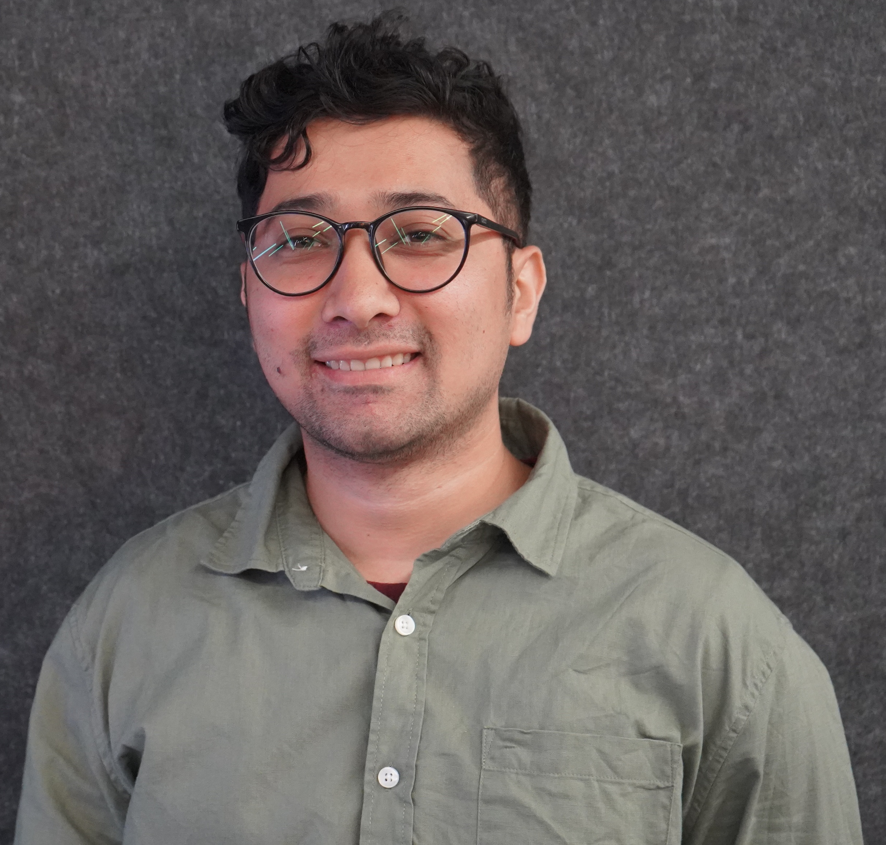
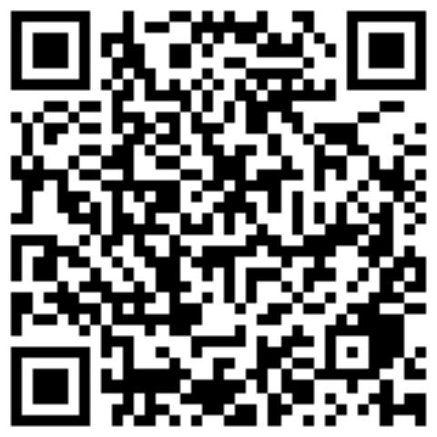
Let's Connect
About Me
I'm Rohit, originally from Nepal and currently exploring opportunities in the tech industry with a focus on cloud computing and artificial intelligence.
I'm passionate about making advanced technology accessible to everyone, regardless of their technical background.
Linked In

